Slide 1
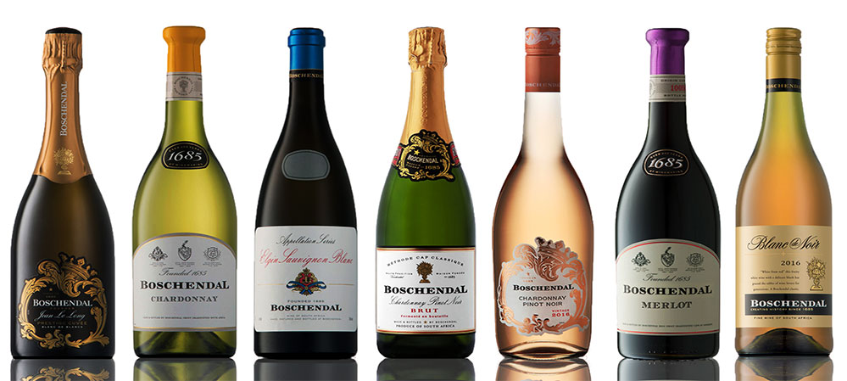
Predicting Wine Quality
2017-2 Machine Learning Term Project
2015104226 YunMin Cho

Slide 2

Index
Introduction
Preparing data set
Training Model
Conclusion

Slide 3


Introduction
How do people know wine quality?
In the past, only wine connoisseurs could evaluate the quality.
No one knows why they are different except for the wine connoisseurs.
In the late 1900’s, Orley Clark Ashenfelter predicted
relationship between wine quality and weather.
와인의 품질 = 12.145 + 0.00117*겨울철 강수량 + 0.0614*재배철의 평균 기온 – 0.00386*수확기 강수량

Slide 4
Introduction
Is it impossible to predict the quality just using the information of wine?
-> This project predicts wine quality only using the information of wine.
Using Tensorflow as machine learning tool
Data set file extension: CSV (I did data normalization.)
Model: Multilayer Perceptron
Using Sigmoid as activation function / Using Softmax at last layer
Using AdamOptimizer as optimization function

Slide 5
Preparing Data Set
About Data Set
Data Set Characteristics: | Multivariate | Number of Instances: | 4898 | Area: | Business
Attribute Characteristics: | Real | Number of attributes: | 12 | Date Donated: | 2009-10-07
Associated Tasks: | Classification, Regression | Missing Values? | N/A | Number of Web Hits: | 525588
Fixed acidity / volatile acidity / Citric acid / Residual sugar / Chlorides / Free sulfur dioxide / Total sulfur dioxide / Density / pH / Sulphates / Alcohol / Quality
12th attribute is wine quality(score: 0 ~ 10)
-> Bad(0~5) / Normal(6) / Good(7~10)

Slide 6
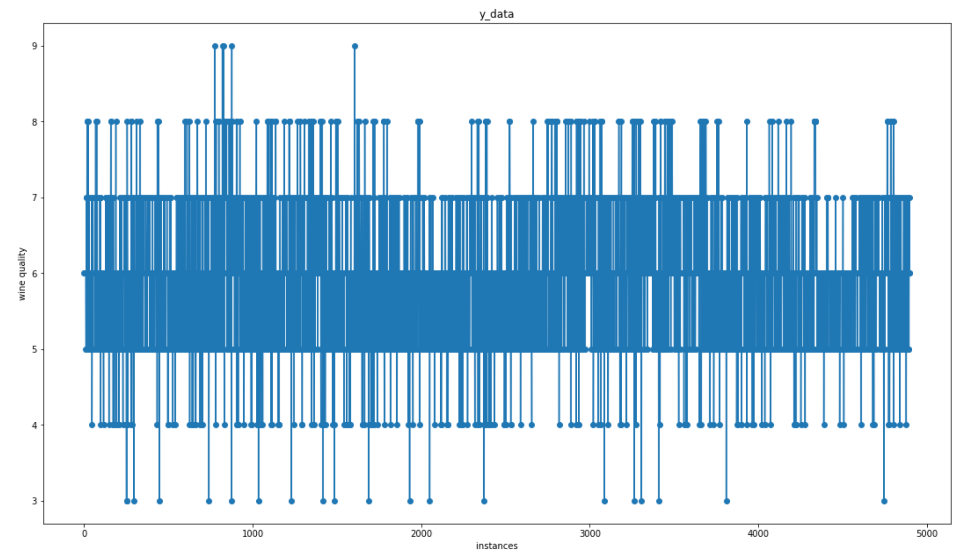
Preparing Data Set
About Data Set
12th attribute is wine quality(score: 0 ~ 10)
-> Bad(0~5) / Normal(6) / Good(7~10)

Slide 7
Preparing Data Set
About Data Set
Two data files: White wine / Red wine
There is no difference between the two except number of instances.
White wine: 4898 instances
Red wine: 1599 instances

Slide 8
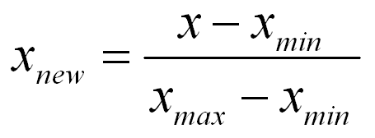
Preparing Data Set
Data Preprocessing
Original data set is irregular in scope.
First instance: 7;0.27;0.36;20.7;0.045;45;170;1.001;3;0.45;8.8;6
-> Data preprocessing is needed.
Data normalization
After normalization, all values of x_data are into the range [0, 1].

Slide 9
Preparing Data Set
Data Preprocessing
<Y_data>
Bad = 0
Normal = 1
Good = 2

Slide 10
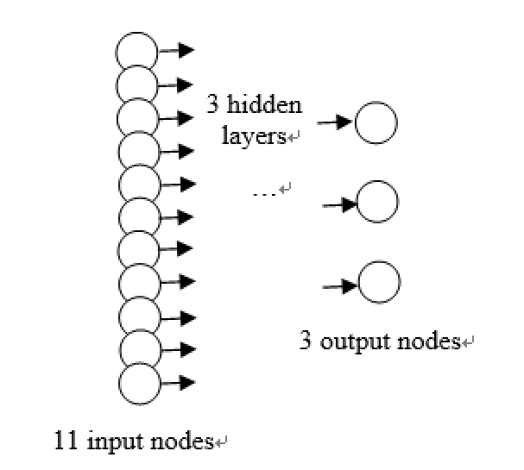
Training Model
Multilayer Perceptron
Because I have 3 classes(bad, normal, good), I have to do multinomial classification.
-> Multilayer Perceptron

Slide 11
Training Model
Training
Number of hidden layers | 3
Activation function | Sigmoid / Softmax(only output layer)
Optimization function | Adam Optimizer
Learning rate | 0.001
Training epoch | 70

Slide 12
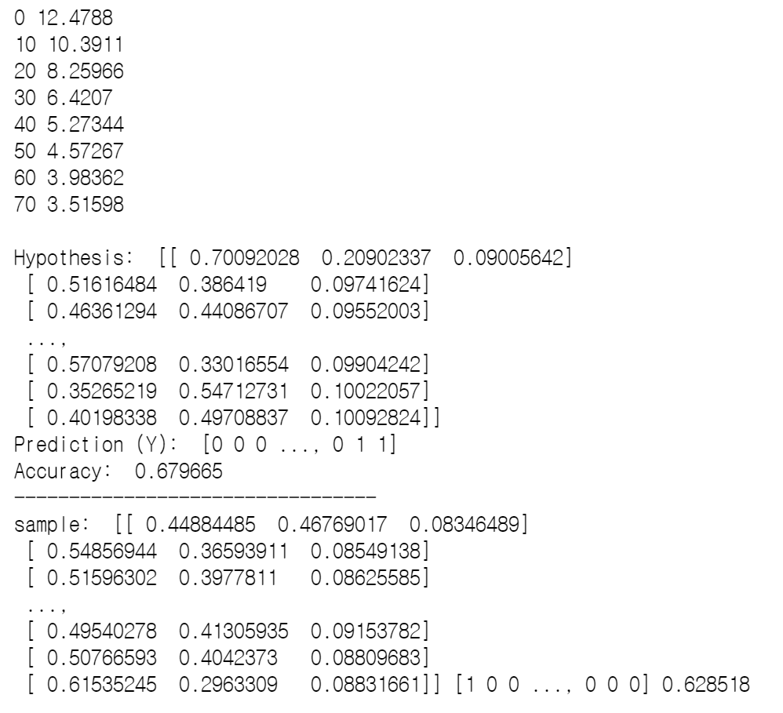
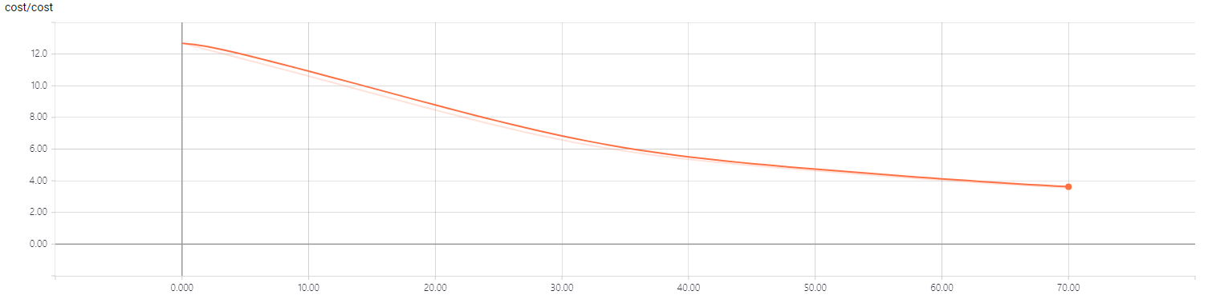
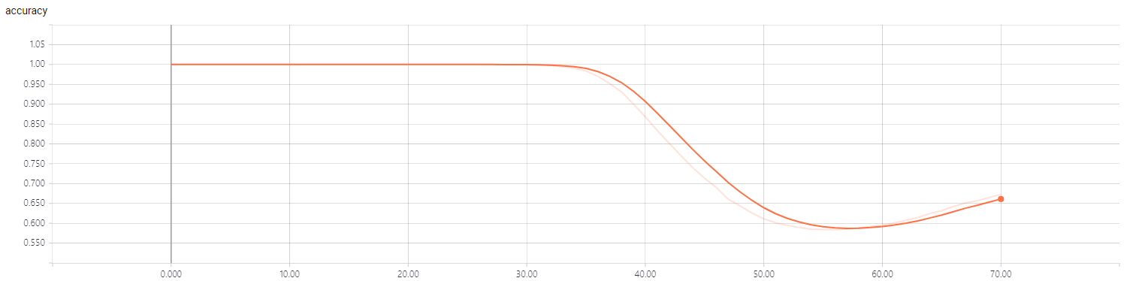
Conclusion
My project conclusion

Slide 13
Conclusion
Test Model

Slide 14
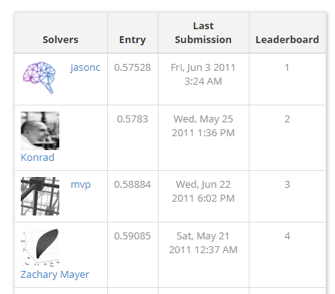
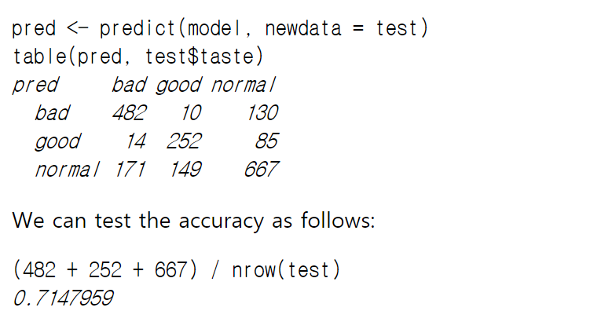
Conclusion
Related Preceding Research

Slide 15
Question!

